Slide 1

Release Plan + Product RoadMap
Team: Harrison Seitz, Malvika Singh, Nicole Yin, Tyler Wright
June 12, 2024

Slide 2
Value Proposition & Competitive Positioning
For small gym business owners and trainers with clients,
Who need an integrated system to provide personalized fitness and wellness programming to their clients, Peloton Breakaway is a solution that helps gym businesses and trainers provide tailored workout regimens, schedule workouts and monitor individual performance and fitness. This enhances both gym and remote exercise sessions for clients, providing a seamless fitness experience.
Unlike competitors in the connected fitness sector, Peloton Breakaway is a one-stop solution for effectively engaging with clients to give them holistic, engaging and 1:1 fitness experience. By offering versatile fitness solutions, Peloton Breakaway fosters higher satisfaction and retention rates.

Slide 3
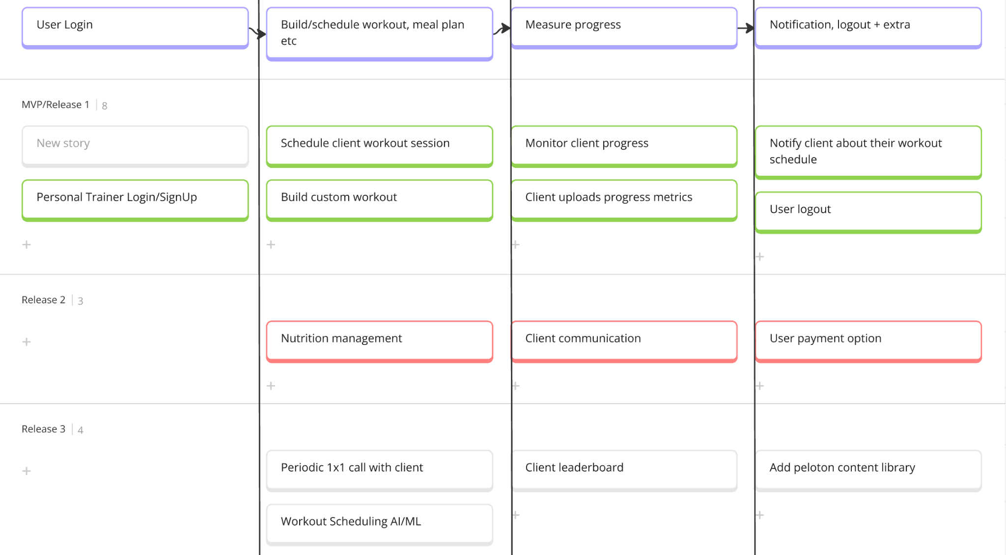
Story Mapping

Slide 4
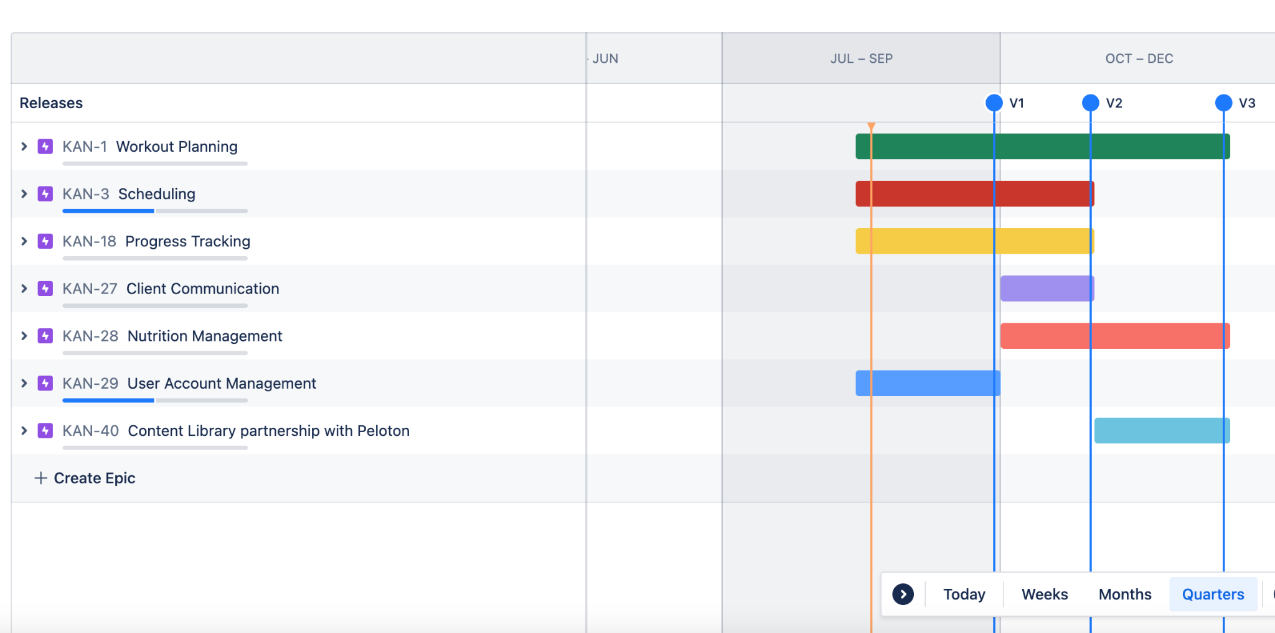
Release Plan

Slide 5
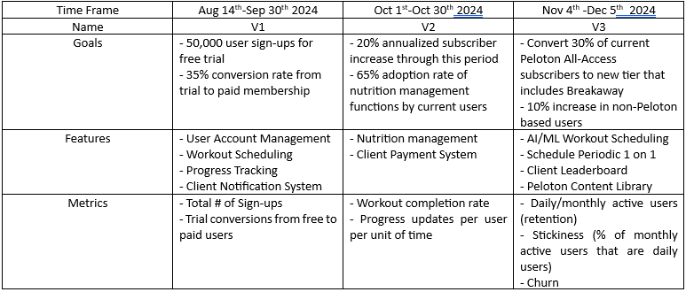
Product RoadMap I

Slide 6
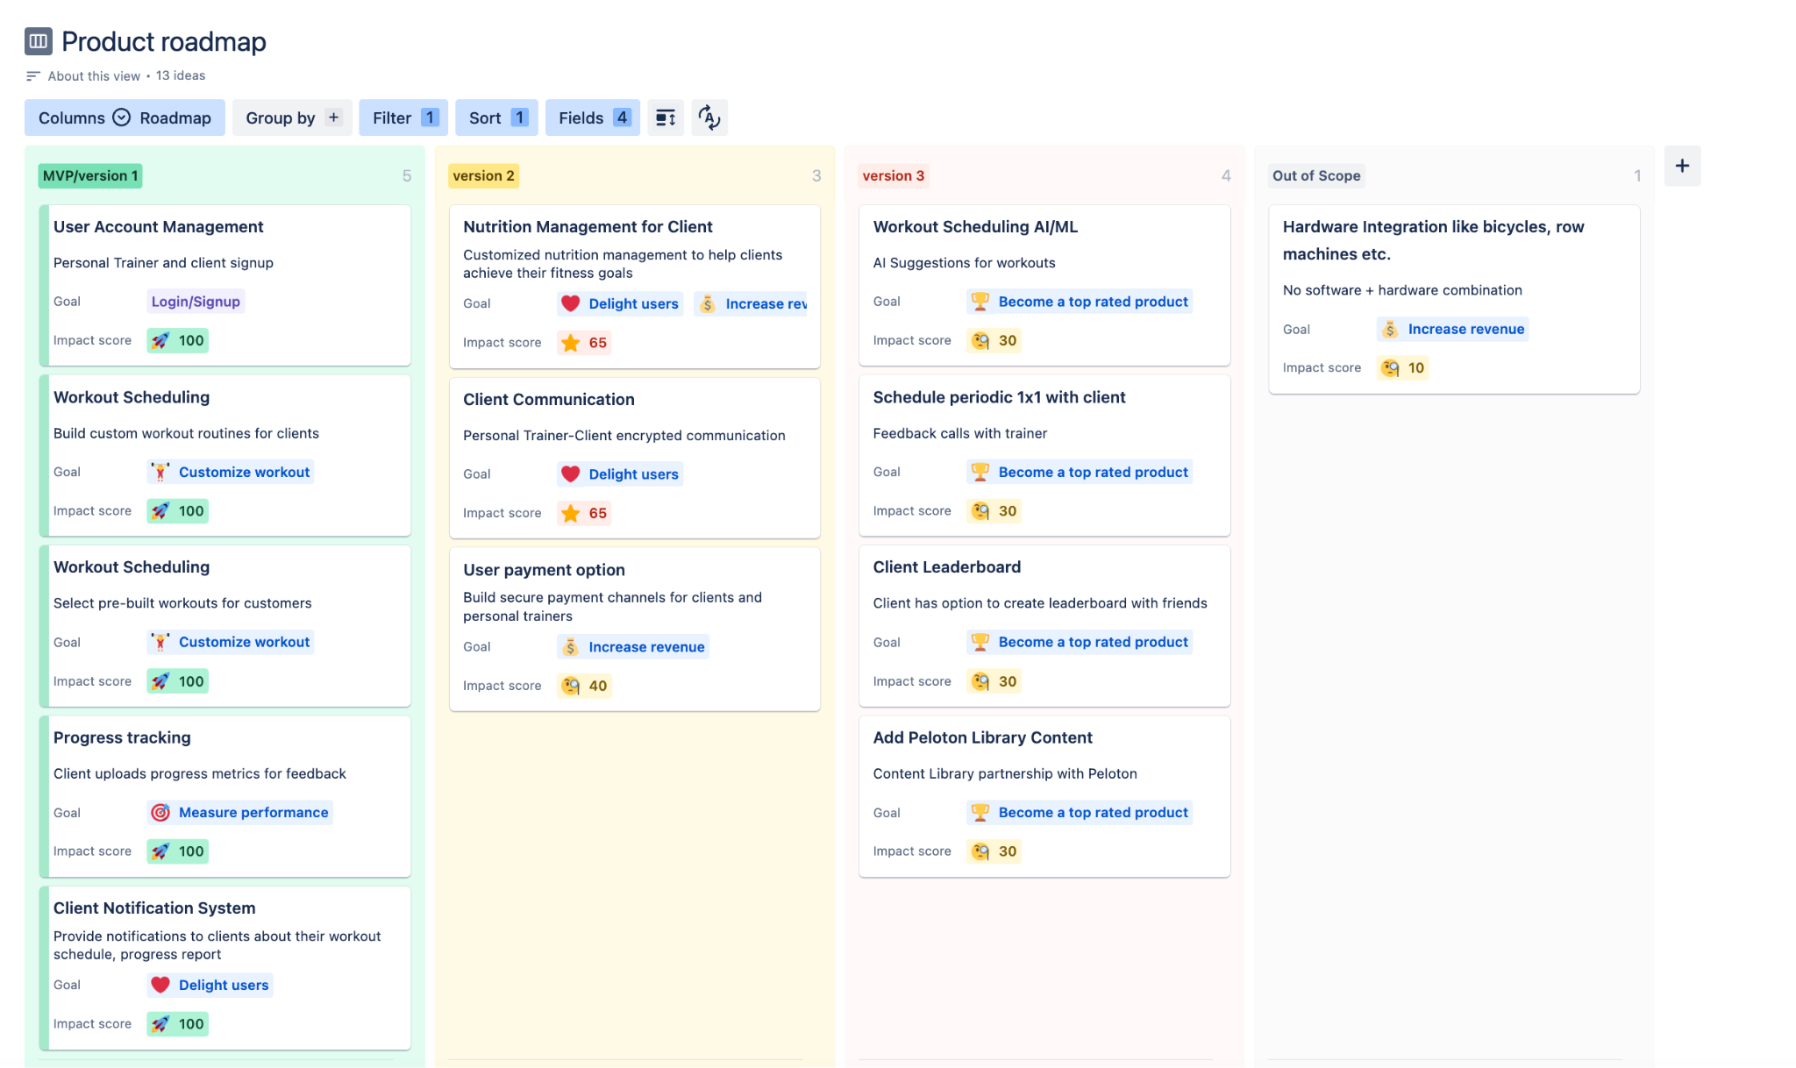
Product RoadMap In Jira

